Slide 1



MASTER THESIS PROJECT
Presented by 2022AIM1007
Supervised by - Prof. Jagpreet Singh

Slide 2


CONTENT
01
INTRODUCTION
02
PROBLEM
03
LITERATURE REVIEW
04
RESEARCH OBJECTIVES
05
METHODOLOGY
06
RESULTS
07
UPCOMING WORK

Slide 3


Over the past decade, Wireless Sensor Networks (WSNs) have gained increasing traction for real-world data collection. WSNs typically consist of battery-powered sensor nodes, but limited battery capacity hinders their operational lifespan. To address this, various approaches have been proposed, including energy conservation and battery replacement.
A breakthrough in Wireless Power Transfer (WPT), particularly magnetic resonant coupling , offers an alternative solution to recharge sensor node batteries. WPT provides advantages like resilience to environmental conditions, precise power control, and conductor-free charging .
Wireless charging has gained significant attention as a means to extend sensor node lifespans. This research focuses on optimizing system performance through strategic wireless charger deployment.
INTRO
DUCTION
page 2

Slide 4
In our research, our work revolves around the problem of minimizing charger placement while ensuring that the energy needs of each sensor node are adequately met. This entails devising a strategic approach for positioning wireless chargers from a random set of candidate locations. The primary objectives are to fulfill the energy requirements of individual sensor nodes while simultaneously minimizing the overall number of utilized chargers.
Moreover, we establish the NP-hardness of the problem . For directional charging scenarios, we use different methodologies of placement and then select the best one with comparison. In the case of directional charging, we initiate the process by extracting candidate orientation sets for each candidate charger location. This reduces the search space from an infinite range to a finite set. Subsequently, we hope to propose a algorithm with a proven performance guarantee.
Finally, our research findings would be substantiated through extensive numerical simulations, where we employ directional antennas and employ the vertex cover algorithm to optimize charger placement.
page 3

Slide 5



WIRELESS CHARGER PLACEMENT
OPTIMIZATION IN WSN
j
Energy Limitations: Sensor nodes in WSNs rely on limited onboard battery capacity.
Network Longevity: The constrained energy capacity of sensor nodes restricts the operational lifespan of WSNs.
Charger Placement Complexity: Traditional charger placement strategies may not maximize network efficiency.
PROBLEM
page 4

Slide 6
Page 06
Literary Review
"Optimal Wireless Charger Placement with Individual Energy Requirement"
Authors: Xingjian Ding, Jianxiong Guo, Deying Li, Weili Wu
Focus: Optimal charger placement in WSNs with individualized energy requirements.
Contribution: Proposes a novel methodology for strategic charger placement based on sensor node energy needs.
Result: Enhanced network lifetime and improved energy efficiency
Literary Review
01
"Wireless Power Transfer and Energy Harvesting in Distributed Sensor Networks: Survey, Opportunities, and Challenges"
Authors: Gerald K Ijemaru, Kenneth Li-Minn Ang, Jasmine KP Seng
Focus: Comprehensive survey of WPT and energy harvesting in sensor networks.
Insights: Reviews various techniques and technologies, highlighting opportunities and challenges.
Significance: Provides a holistic overview of the field, guiding future research directions
Literary Review
02

Slide 7
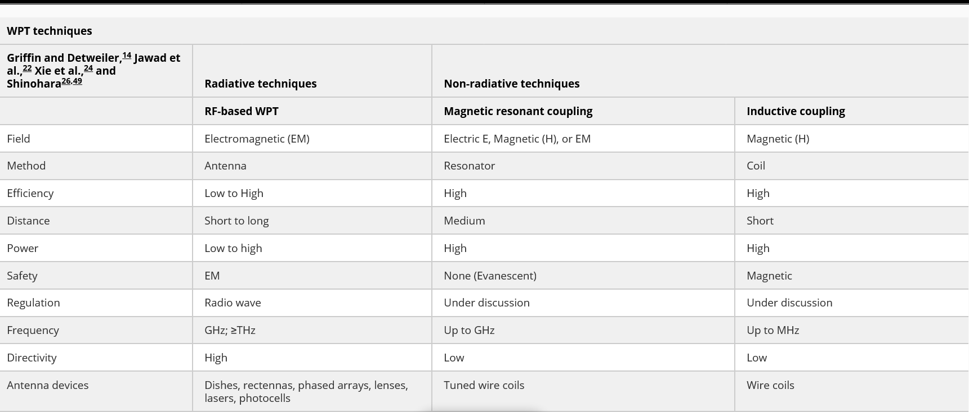

Slide 8



Develop an Optimized Charger Placement Strategy
Create a novel methodology for strategically placing wireless chargers in WSNs in directional domain.
Tailor charger placement to minimize number of antennas , maximizing energy utilization.
Objectives 1
OBJECTIVES
Quantify the Impact on WSN Performance
Conduct comprehensive simulations to assess the effectiveness of the proposed charger placement strategy.
Provide clear quantitative evidence of the benefits achieved by the optimized charger placement approach.
Objectives 2
page 6

Slide 9


Methodology 1- BASELINE
Step 1: Charger Placement Simulation
Charger placement at every node .
Consider various charger locations and angles to ensure adequate coverage.
Step 2: Node Coverage Assessment
For each charger location and angle, assess the coverage range of wireless charging.
Identify the sensor nodes within the coverage area of each charger
METHO
DOLOGY
Methodology2 -Random Placement
Step 1: Randomly select charger locations within the WSN deployment area.
Randomly assign charging angles for each charger, considering a range of orientations.
Step 2: Node Coverage Assessment
Assess the coverage range of each randomly placed charger with its angle and Identify the sensor nodes located within the charging coverage area of each charger
page 7

Slide 10



IMPLEMENTATION
01
02
03
04
PLATFORM
SIMULATION
DATA GEN
DATASET
Selection of Platforms to work on e.g. MATLAB,OMNET ,SI MULINK etc.
GUI based or code based simulation of the network and wpt placement to generate results
Generation of Data for various paramters e,g. Area, Density, Nodes, Angle etc.
Removing noise from the output data and collecting unbiased useful data to be used as perfomance metric in comparing methodologies

Slide 11
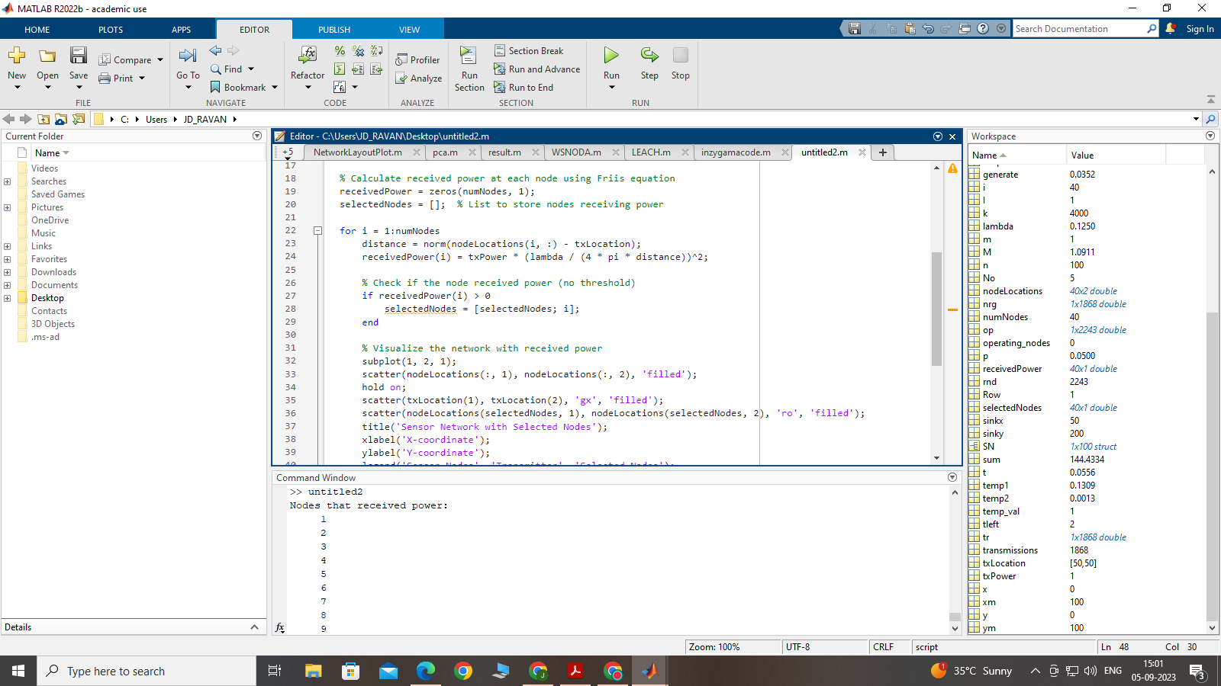
Results
Page 9

Slide 12
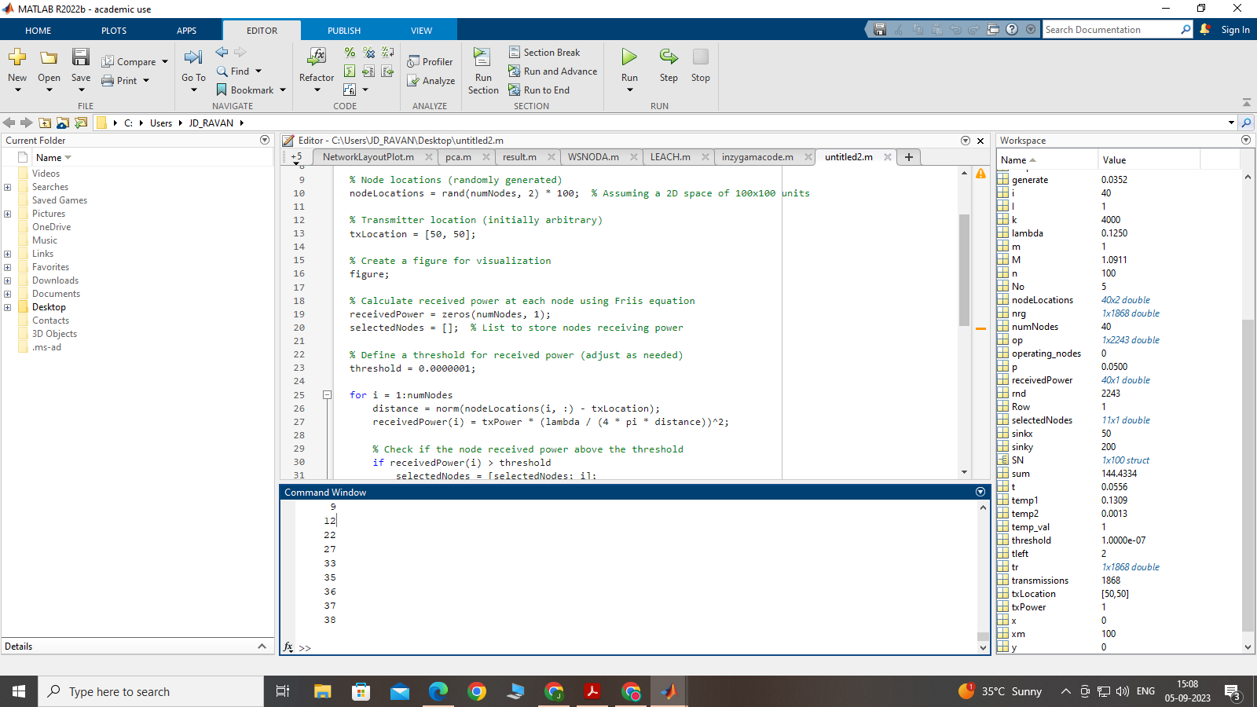
Results
Page 10

Slide 13


Results include simulation of wsn and provides data of sets with omnidirectional Antenaa placement to be known or entered by the user
It generates dataset of nodes which recieved power sufficient to operate.
.
Furthermore building up on methodologies using Dataset provided by the Supervisor.
Work on Baseline methodology has been in progress as directional component has to be included yet.
DISCUSSION
11

Slide 14

QUESTIONS

Slide 15






REFERENCES
F.K. Shaikh, S. Zeadally, Energy harvesting in wireless sensor networks: a comprehensive review, Renew. Sustain. Energy Rev. 55 (2016) 1041–1054
H. Dai, X. Wang, A.X. Liu, H. Ma, G. Chen, Optimizing wireless charger placement for directional charging, in: IEEE INFOCOM 2017-IEEE Conference on
Computer Communications, IEEE, 2017, pp. 1–9
Wireless power transfer and energy harvesting in distributed sensor networks: Survey, opportunities, and challenges
Gerald K Ijemaru, Kenneth Li-Minn Ang https://orcid.org/0000-0002-2402-7529 lang@usc.edu.au, and Jasmine KP Seng

Slide 16
THANK YOU

